Slide 1
Session 8

Slide 2
Content of session
01
02
04
03
Objective
Rules
Core loop
05
Feedback
Balance

Slide 3
01
Objective

Slide 4
Objective
The Objective is the main goal the player is trying to achieve in the game.
It gives the player purpose.
A clear goal gives the player a reason to care, act, and keep playing.

Slide 5
Objective
Also we have 2 types of objective:
Short-Term Objective:
A goal that the player must achieve within a limited timeframe or scope, typically within a single level or session. It provides immediate motivation and feedback, helping guide moment-to-moment gameplay.
Long-Term Objective:
A goal that spans a larger portion or the entirety of the game. It represents the player's ultimate purpose or endgame, providing overarching direction and narrative motivation.

Slide 6
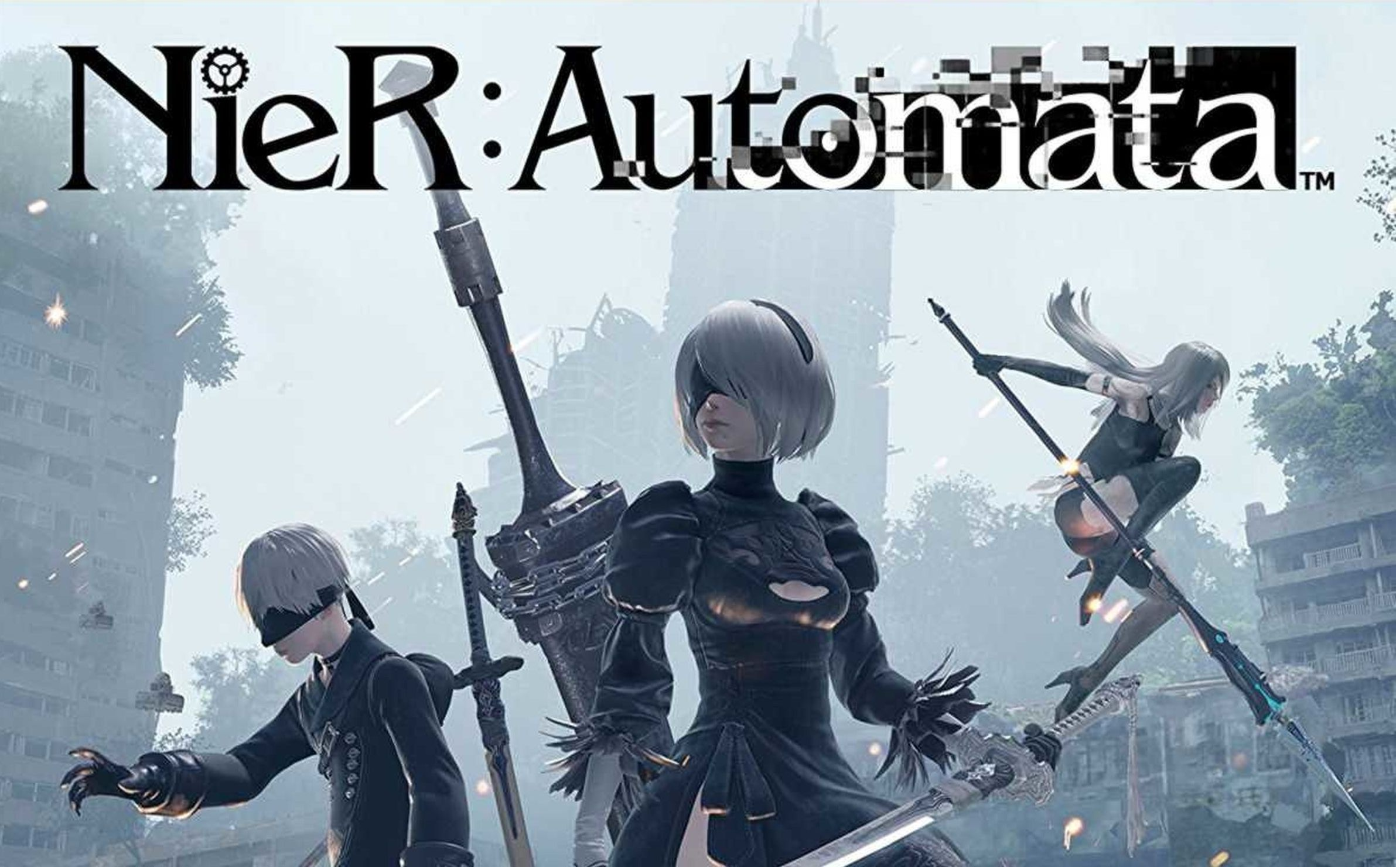
Objective
NieR: Automata:
Long-Term Objective:
The objective is to uncover the truth behind the war between androids and machines.
and resolve the fate of humanity through multiple playthroughs and story arcs.
Short-Term Objective:
Complete a mission, such as eliminating a specific enemy unit or retrieving data from a location.

Slide 7
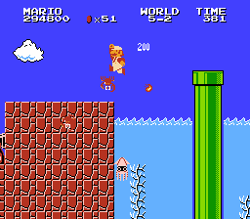
Objective
Super Mario bros:
Short-Term Objective:
Reach the flagpole at the end of a level while avoiding enemies and obstacles.
Long-Term Objective:
Rescue Princess Peach from Bowser by completing all worlds and defeating the final boss.
Notes:
مش لازم يكون موجود النوعين ممكن نوع واحد بس يقوم بالواجب

Slide 8
02
Rules

Slide 9
Rules
Rules define what players can and cannot do in the game.
They shape the gameplay experience by creating structure, challenges, and boundaries.
Rules create trust between player and the game.
Purpose of Rules:
-Guide player behavior
-Create fairness and consistency
-Support the game’s challenge and balance
-Make gameplay meaningful and engaging

Slide 10
Rules
Examples:
In chess: Each piece moves in a specific way.
Minecraft: You can’t sleep if there are enemies around you.
Ori and the Blind Forest: Some areas are locked until you gain specific abilities.

Slide 11
03
Core loop

Slide 12
Core Loop
The Core Loop is the main cycle of actions that players repeat throughout the game.
It’s the heart of the gameplay experience, and everything in the game is built around it.
In Simple Terms:
Core Loop = Action → Reward → Progress → Repeat
Ore and the blind forest:
Core Loop = discover → fight → collect → open new area → Repeat

Slide 13
04
feedback

Slide 14
Feedback
Feedback is how the game communicates the result of the player's actions.
It tells the player whether
they’re doing well, failing,
or making progress.
Notes:
غلس عليا يا يوسف

Slide 15
05
Balance

Slide 16
Game Balance
Game Balance is the process of making sure all elements in the game are fair, useful, and fun —nothing is too powerful, and nothing feels useless.
Goal of Game Balance:
To give players a variety of meaningful and enjoyable choices, where each option is effective in its own unique way.

Slide 17
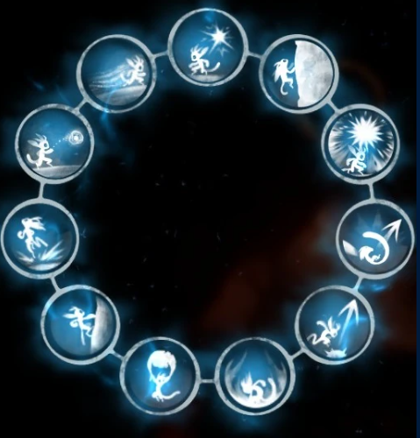
Game Balance
1-Balance Between Abilities:
In games like Ori and the Blind Forest, each ability has a specific purpose.
(Double jump , bash, wall jump, Spirit Flame.)
There’s no single "best" skill — instead, each one is useful in different situations.

Slide 18
Game Balance
2-Balance Between Risk and Reward:
Players are encouraged to take risks when the potential reward is worth it.
For example, Some side quests in NieR: Automata take you into dangerous enemy zones or ask you to make tough moral choices.
But completing them can unlock powerful weapons, story lore, or alternate endings — rewarding players who take the risk.

Slide 19
Game Balance
3-Balance Between Systems (Economy, Upgrades, etc.):
The game should pace progression carefully.
Don’t let the player upgrade everything too quickly,
but also avoid forcing boring grinding to earn upgrade points.
Notes:
The Witcher 3 (cows leather)

Slide 20
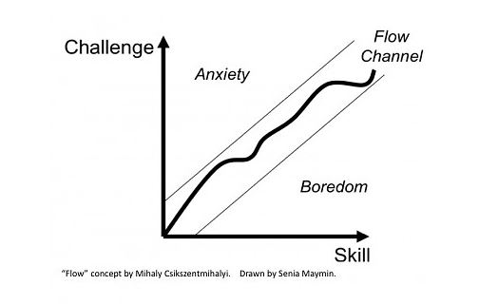
Game Balance
4-Flow:
Flow is the mental and emotional state where the player is fully immersed in the game.
It happens when the challenge matches the player's skill.
not too easy (boring),
and not too hard (frustrating).

Slide 21
Game Balance
Goal of Flow:
Keep the player in “The Zone” fully focused, deeply engaged, and completely immersed in the game.
When done right, the player loses track of time because they’re so into the experience.

Slide 22
Game Balance
How to Achieve Flow:
1-Balance Challenge and Skill:
-Too hard → leads to frustration
-Too easy → leads to boredom
2-Introduce New Challenges Gradually.
3-Responsive Gameplay:
The player should feel fully in control, with instant feedback.
Notes:
زي ريبونبون الفرق بين ليفل 1 و 2

Slide 23
Fun
And Above All... The Game Should Be Fun
No matter how well-designed the systems are
If the player isn’t having fun, none of it matters.
Fun is the ultimate goal that ties everything
together:
Objectives, Flow, Feedback, Balance — all should serve the player’s enjoyment.
Notes:
الاهم ان اللعبة تكون ممتعة و مش شرط نطبق كل الحاجات دي عشان تكون لعبة كويسة
كله بالتجرية و خلي ناس تجرب

Slide 24
Exercise 1

Slide 25
Exercise 2
Notes:
الفيديو بعدين كل واحد يقول ال 5 عناصر في كل لعبة و يقول ممكن يحسنها ازاي و اية اللي ناقص
https://youtu.be/J80-1BoJQN8?si=JAMWHcuq7gzdTIPG

Slide 26
Thanks!
Any Questions

